Slide 1
CSE477
VLSI Digital Circuits
Fall 2002
Lecture 26: Low Power Techniques in
Microarchitectures and Memories
Mary Jane Irwin ( www.cse.psu.edu/~mji ) www.cse.psu.edu/~cg477
[Adapted from Rabaey’s Digital Integrated Circuits, ©2002, J. Rabaey et al.]

Slide 2
Review: Energy & Power Equations
E = C_{L} V_{DD}² P_{0→1} + t_{sc} V_{DD} I_{peak} P_{0→1} + V_{DD} I_{leakage}
P = C_{L} V_{DD}² f_{0→1} + t_{sc}V_{DD} I_{peak} f_{0→1} + V_{DD} I_{leakage}
f_{0→1} = P_{0→1} * f_{clock}
Dynamic power
(~90% today and decreasing relatively)
Short-circuit power
(~8% today and decreasing absolutely)
Leakage power
(~2% today and increasing)
Notes:
f0->1 represents the energy consuming transition

Slide 3
Power and Energy Design Space
 | Constant Throughput/Latency |  | Variable Throughput/Latency
Energy | Design Time | Non-active Modules |  | Run Time
Active | Logic Design Reduced V_{dd} Sizing Multi-V_{dd} | Clock Gating |  | DFS, DVS (Dynamic Freq, Voltage Scaling)
Leakage | + Multi-V_{T} | Sleep Transistors Multi-V_{dd} Variable V_{T} |  | + Variable V_{T}
Notes:
Physical capacitance: circuit style selection, transistor sizing, placement and routing, architectural optimizations.
input and output rise/fall times – determines short-circuit power
device thresholds and temperature – impacts leakage power
switching activity

Slide 4
Bus Multiplexing
Buses are a significant source of power dissipation due to high switching activities and large capacitive loading
  15% of total power in Alpha 21064
  30% of total power in Intel 80386
Share long data buses with time multiplexing (S₁ uses even cycles, S₂ odd)
S₁
D₁
S₁
D₁
S₂
D₂
S₂
D₂
But what if data samples are correlated (e.g., sign bits)?

Slide 5
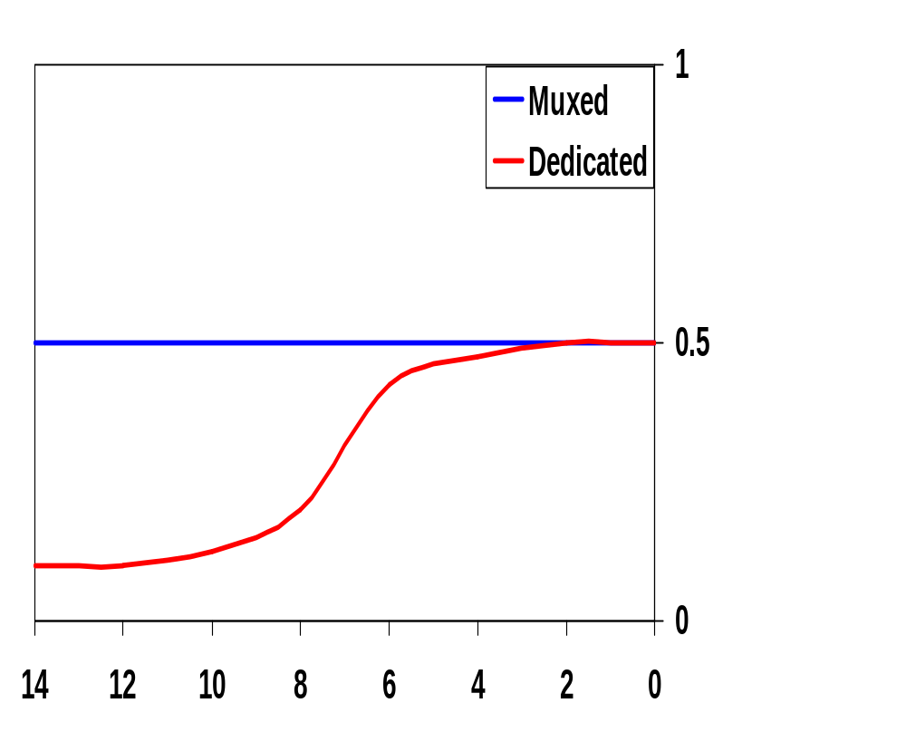
Correlated Data Streams
For a shared (multiplexed) bus advantages of data correlation are lost (bus carries samples from two uncorrelated data streams)
  Bus sharing should not be used for positively correlated data streams
  Bus sharing may prove advantageous in a negatively correlated data stream (where successive samples switch sign bits) - more random switching
Bit switching probabilities
MSB
LSB
Bit position

Slide 6
Glitch Reduction by Pipelining
Glitches depend on the logic depth of the circuit - gates deeper in the logic network are more prone to glitching
  arrival times of the gate inputs are more spread due to delay imbalances
  usually affected more by primary input switching
Reduce logic depth by adding pipeline registers
  additional energy used by the clock and pipeline registers
Fetch
Decode
Execute
Memory
WriteBack
PC
I$
Instruction
MAR
D$
MDR
pipeline
stage
isolation
register
clk
Notes:
Five stage pipeline (originally for performance, but also helps with energy)

Slide 7
Power and Energy Design Space
 | Constant Throughput/Latency |  | Variable Throughput/Latency
Energy | Design Time | Non-active Modules |  | Run Time
Active | Logic Design Reduced V_{dd} Sizing Multi-V_{dd} | Clock Gating |  | DFS, DVS (Dynamic Freq, Voltage Scaling)
Leakage | + Multi-V_{T} | Sleep Transistors Multi-V_{dd} Variable V_{T} |  | + Variable V_{T}
Notes:
Physical capacitance: circuit style selection, transistor sizing, placement and routing, architectural optimizations.
input and output rise/fall times – determines short-circuit power
device thresholds and temperature – impacts leakage power
switching activity

Slide 8
Clock Gating
Most popular method for power reduction of clock signals and functional units
Gate off clock to idle functional units
  e.g., floating point units
  need logic to generate disable signal
    increases complexity of control logic
    consumes power
    timing critical to avoid clock glitches at OR gate output
  additional gate delay on clock signal
    gating OR gate can replace a buffer in the clock distribution tree
R
e
g
Functional
unit
clock
disable
Notes:
Motorola’s Mcore numbers for number of pipeline latches disabled by clock gating on pipeline stall

Slide 9
Clock Gating in a Pipelined Datapath
For idle units (e.g., floating point units in Exec stage, WB stage for instructions with no write back operation)
Fetch
Decode
Execute
Memory
WriteBack
PC
I$
Instruction
MAR
D$
MDR
clk
No FP
No WB

Slide 10
Power and Energy Design Space
 | Constant Throughput/Latency |  | Variable Throughput/Latency
Energy | Design Time | Non-active Modules |  | Run Time
Active | Logic Design Reduced V_{dd} Sizing Multi-V_{dd} | Clock Gating |  | DFS, DVS (Dynamic Freq, Voltage Scaling)
Leakage | + Multi-V_{T} | Sleep Transistors Multi-V_{dd} Variable V_{T} |  | + Variable V_{T}
Notes:
Physical capacitance: circuit style selection, transistor sizing, placement and routing, architectural optimizations.
input and output rise/fall times – determines short-circuit power
device thresholds and temperature – impacts leakage power
switching activity

Slide 11
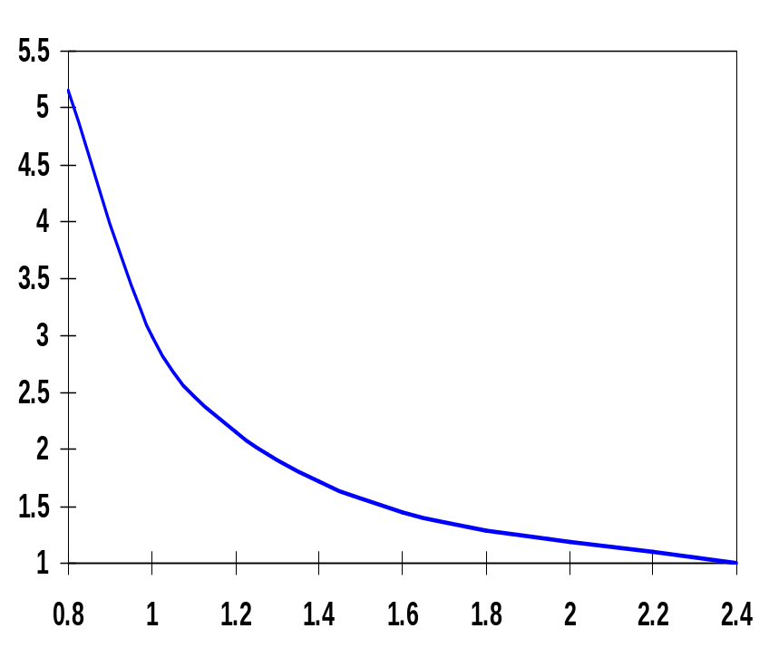
Review: Dynamic Power as a Function of V_{DD}
Decreasing the V_{DD} decreases dynamic energy consumption (quadratically)
But, increases gate delay (decreases performance)
t_{p(normalized)}
V_{DD} (V)
Determine the critical path(s) at design time and use high V_{DD} for the transistors on those paths for speed. Use a lower V_{DD} on the other logic to reduce dynamic energy consumption.
Notes:
Good design practice keeps drain diffusion areas as small as possible
Self-loading is when the intrinsic capacitance (diffusion capacitance) starts to dominate the extrinsic load formed by wiring and fanout.
Propagation delay of a CMOS inverter as a function of supply voltage (normalized wrt delay at 2.5V supply). While the delay is relatively insensitive to supply variations for higher values of VDD, a sharp increase can be observed starting around 2VT. This operation regions should be avoided for high performance! Increasing VDD also has reliability concerns - oxide breakdown, hot-electron effects - that enforce firm upper bounds on the supply voltage in deep submicron processes. Lowering VDD slows down the gate!

Slide 12
Dynamic Frequency and Voltage Scaling
Intel’s SpeedStep
  Hardware that steps down the clock frequency (dynamic frequency scaling – DFS) when the user unplugs from AC power
    PLL from 650MHz → 500MHz
  CPU stalls during SpeedStep adjustment
Transmeta LongRun
  Hardware that applies both DFS and DVS (dynamic supply voltage scaling)
    32 levels of V_{DD} from 1.1V to 1.6V
    PLL from 200MHz → 700MHz in increments of 33MHz
  Triggered when CPU load change is detected by software
    heavier load → ramp up V_{DD}, when stable speed up clock
    lighter load → slow down clock, when PLL locks onto new rate, ramp down V_{DD}
  CPU stalls only during PLL relock (< 20 microsec)
Notes:
Always keeps clock frequency within limits required by V_{DD} to avoid clock skew problems

Slide 13



Dynamic Thermal Management (DTM)
Trigger Mechanism:
When do we enable DTM techniques?
Initiation Mechanism:
How do we enable technique?
Response Mechanism:
What technique do we enable?

Slide 14
DTM Trigger Mechanisms
Mechanism: How to deduce temperature?
Direct approach: on-chip temperature sensors
  Based on differential voltage change across 2 diodes of different sizes
  May require >1 sensor
  Hysteresis and delay are problems
Policy: When to begin responding?
  Trigger level set too high means higher packaging costs
  Trigger level set too low means frequent triggering and loss in performance
Choose trigger level to exploit difference between average and worst case power
Notes:
Average case power dissipation can often be much lower than worst case due to
Aggressive clock gating
Applications variations
Underutilized resources
Not enough ILP
Currently about a 30% difference
Likely to further diverge…

Slide 15
DTM Initiation and Response Mechanisms
Operating system or microarchitectural control?
  Hardware support can reduce performance penalty by 20-30%
Initiation of policy incurs some delay
  When using DVS and/or DFS, much of the performance penalty can be attributed to enabling/disabling overhead
  Increasing policy delay reduces overhead; smarter initiation techniques would help as well
Thermal window (100Kcycles+)
  Larger thermal windows “smooth” short thermal spikes

Slide 16
DTM Activation and Deactivation Cycle
Trigger
Reached
Turn
Response On
Check
Temp
Check
Temp
Turn
Response Off
Initiation
Delay
Response
Delay
Policy
Delay
Shutoff
Delay
Initiation Delay – OS interrupt/handler
Response Delay – Invocation time (e.g., adjust clock)
Policy Delay – Number of cycles engaged
Shutoff Delay – Disabling time (e.g., re-adjust clock)

Slide 17
DTM Savings Benefits
Designed for cooling capacity without DTM
Designed for cooling
capacity with DTM
System
Cost Savings
Temperature
DTM trigger
level
DTM Disabled
DTM/Response Engaged
Time

Slide 18
Power and Energy Design Space
 | Constant Throughput/Latency |  | Variable Throughput/Latency
Energy | Design Time | Non-active Modules |  | Run Time
Active | Logic Design Reduced V_{dd} Sizing Multi-V_{dd} | Clock Gating |  | DFS, DVS (Dynamic Freq, Voltage Scaling)
Leakage | + Multi-V_{T} | Sleep Transistors Multi-V_{dd} Variable V_{T} |  | + Variable V_{T}
Notes:
Physical capacitance: circuit style selection, transistor sizing, placement and routing, architectural optimizations.
input and output rise/fall times – determines short-circuit power
device thresholds and temperature – impacts leakage power
switching activity

Slide 19
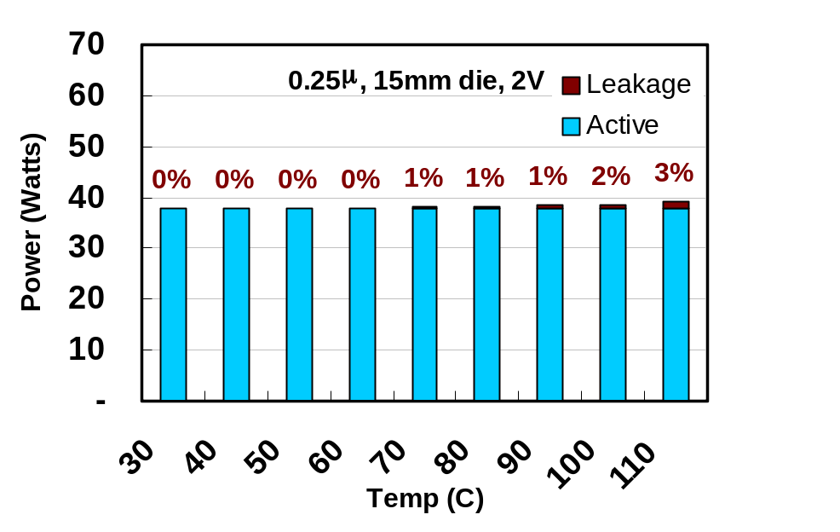
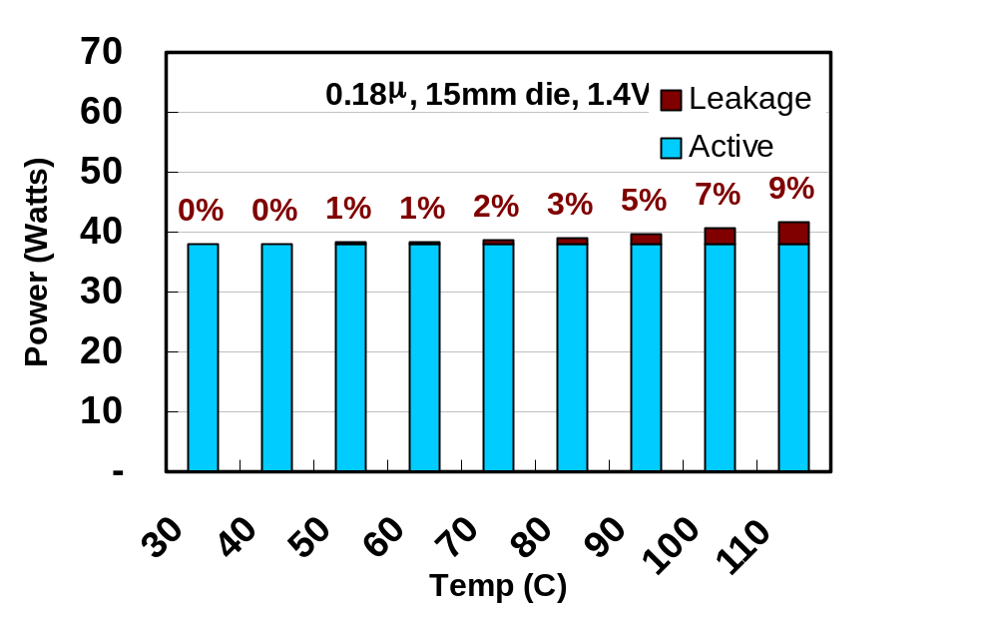
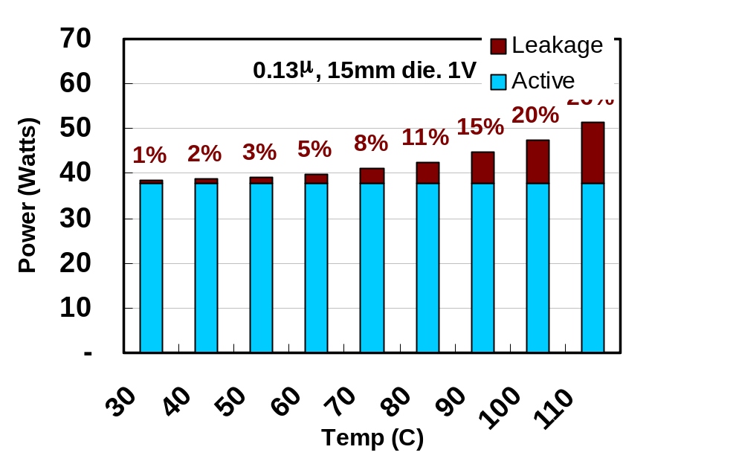
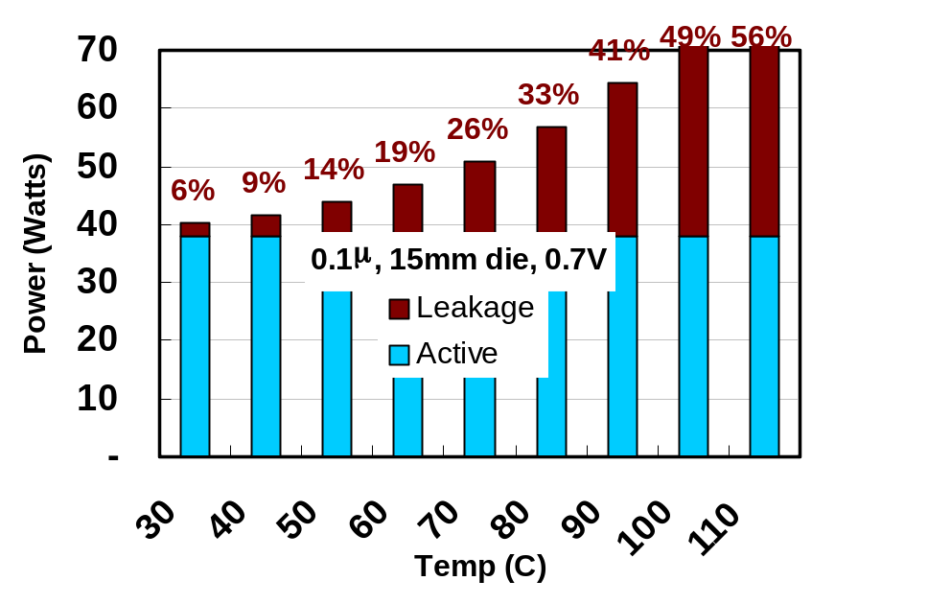
Speculated Power of a 15mm μP

Slide 20
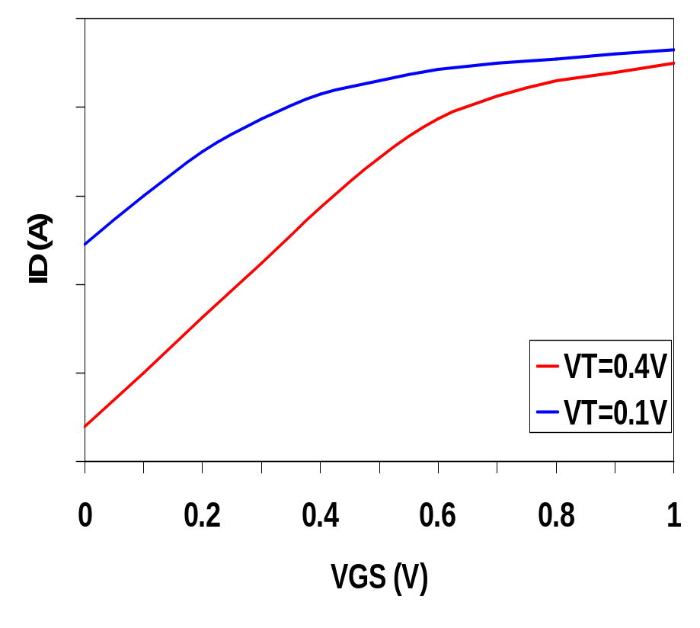
Review: Leakage as a Function of Design Time V_{T}
Reducing the V_{T} increases the sub-threshold leakage current (exponentially)
But, reducing V_{T} decreases gate delay (increases performance)
Determine the critical path(s) at design time and use low V_{T} devices on the transistors on those paths for speed. Use a high V_{T} on the other logic for leakage control.

Slide 21
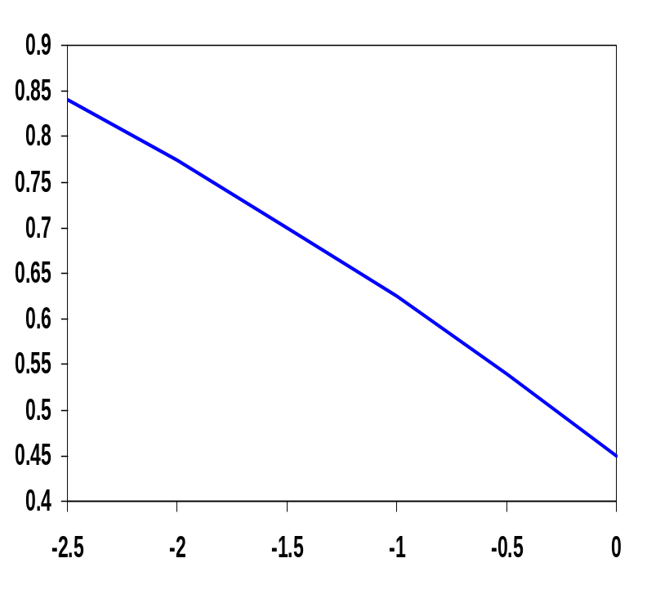
Review: Variable V_{T} (ABB) at Run Time
V_{T} = V_{T0} + γ(√|-2φ_{F} + V_{SB}| - √|-2φ_{F}|)
where V_{T0} is the threshold voltage at V_{SB} = 0
V_{SB} is the source-bulk (substrate) voltage
γ is the body-effect coefficient
For an n-channel device, the substrate is normally tied to ground
A negative bias causes V_{T} to increase from 0.45V to 0.85V
Adjusting the substrate bias at run time is called adaptive body-biasing (ABB)
V_{T} (V)
V_{SB} (V)
Notes:
Value of VGS where strong inversion occurs is VT
VSB is the source to bulk (body) or substrate bias (note relationship to body effect)
For tox = 5 nm then Cox = 7fF/micron^2 (typical tox less than 10nm (==100 angstroms) in today’s technology)
Typical values for NA = 10**15 atoms/cm**3 and ND = 10**16 atoms/cm**3
Observe that the threshold voltage has a positive value for a normal NMOS device and a negative for a normal PMOS device

Slide 22
Next Lecture and Reminders
Next lecture
  System level interconnect
    Reading assignment – Rabaey, et al, xx
Reminders
  Project final reports due December 5th
  Final grading negotiations/correction (except for the final exam) must be concluded by December 10th
  Final exam scheduled
    Monday, December 16th from 10:10 to noon in 118 and 121 Thomas

